Slide 1


Progetto Pepper Sociale
Task: Object Detection

Slide 2
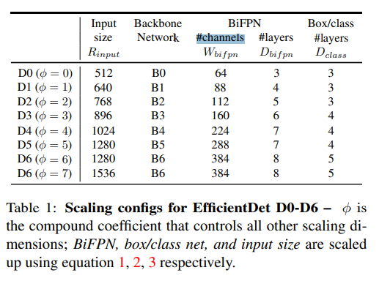
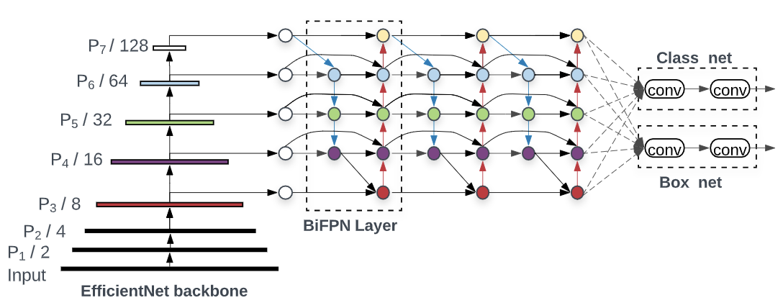
Model: EFFICIENTdEt D3
Built with EfficientNet as backbone, pretrained on ImageNet dataset
Pre-trained Model: EfficientDet D3
Speed: 54 ms and Coco mAP: 38.4
Dataset used to train: COCO17
Number of classes: 90

Slide 3
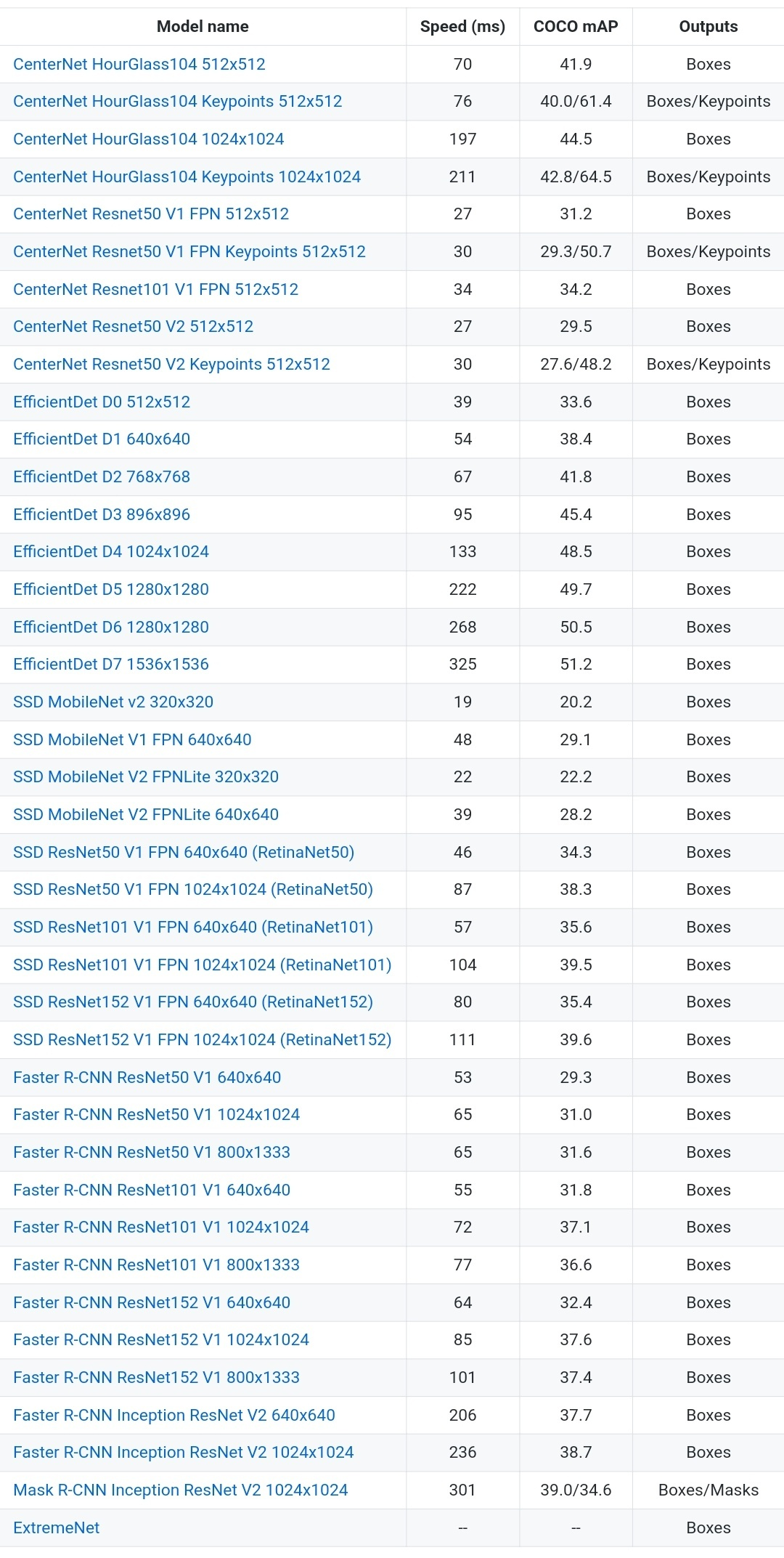
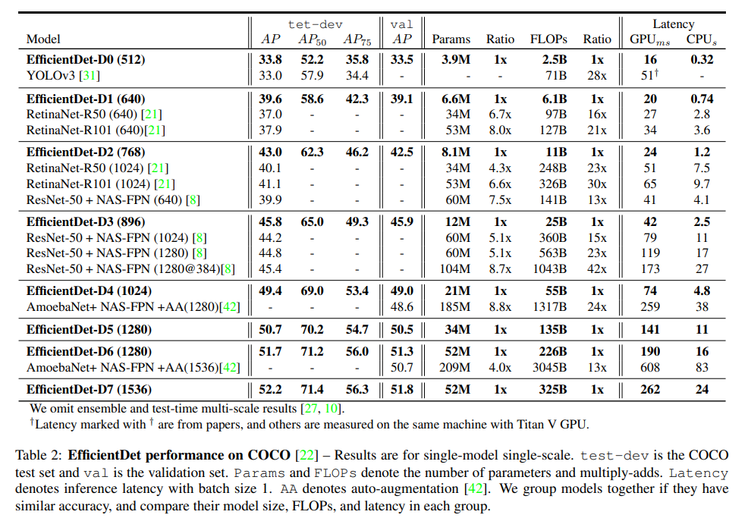
MODEL Choice:
These are the sources according to which the choice of the model was made.
https://openaccess.thecvf.com/content_CVPR_2020/html/Tan_EfficientDet_Scalable_and_Efficient_Object_Detection_CVPR_2020_paper.html
https://github.com/tensorflow/models/blob/master/research/object_detection/g3doc/tf2_detection_zoo.md

Slide 4
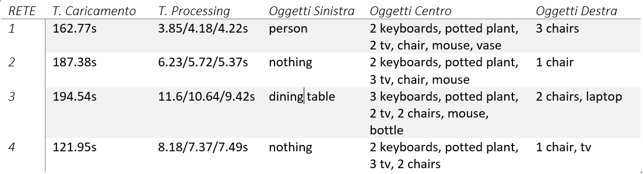
Our TEST ON PEPPER
EfficientDet D1 con input size 640x640
EfficientDet D2 con input size 768x768
EfficientDet D3 con input size 896x896
CenterNet ResNet101 V1 FPN 512x512

Slide 5
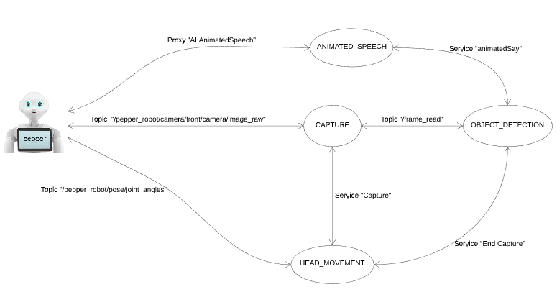
Architecture
Four nodes:
object_detection node for the detection task on images;
stream_capture node for the image acquisition;
head_movement node to manage the head coordinates;
animated_speech node that takes a string in input and let Pepper say it.

Slide 6
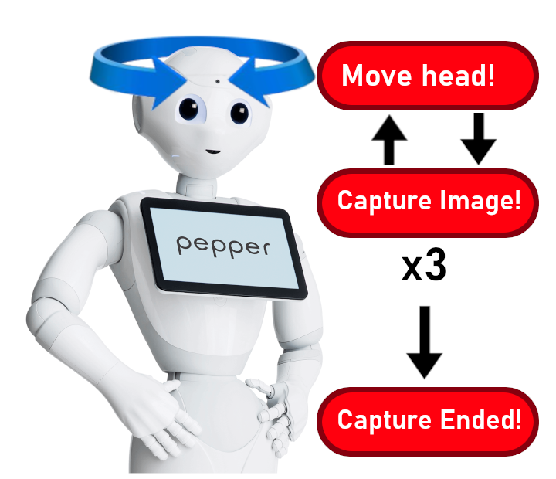
HEAD MOVEMENT
Goal: make Pepper move its head to record the entire scene.
Guarantee coordination between capture operation and movement of the head, so of the camera.
Move Pepper joints by publishing on channel «joint_angles» a message of type «JointAnglesWithSpeed». The interested joints are «HeadPitch» and «HeadYaw»
Call the service «Capture» after executing the movement to get the actual recorded frame when needed, at the end of the retrieving of the three images call the service «capture_ended» to process the result of the detection.

Slide 7
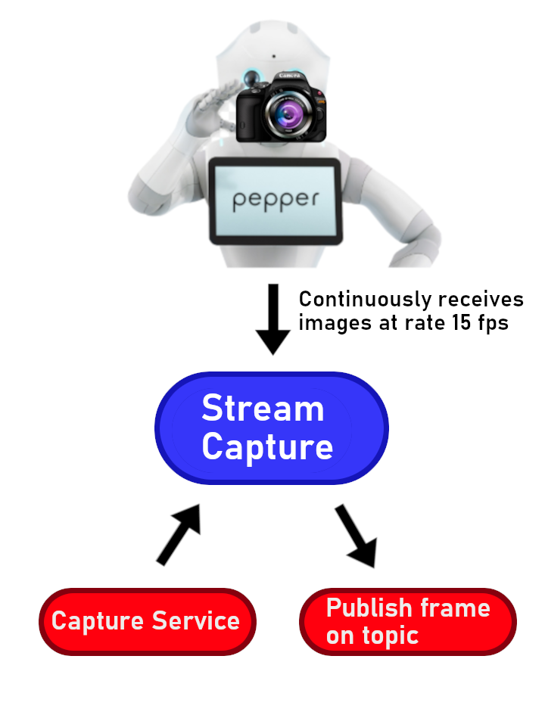
Stream cApture
It is a subscriber of image_raw default topic from Pepper and a publisher of our frame_reader custom topic.
Usally it makes a passive capture of data from image_raw and ignores them, until the node is triggered by another one.
It is also a Server node in Capture Service. The aim is to trigger the node in order to capture actively frames from image_raw.
After an active capture, the node sends the frame on frame_reader topic.

Slide 8
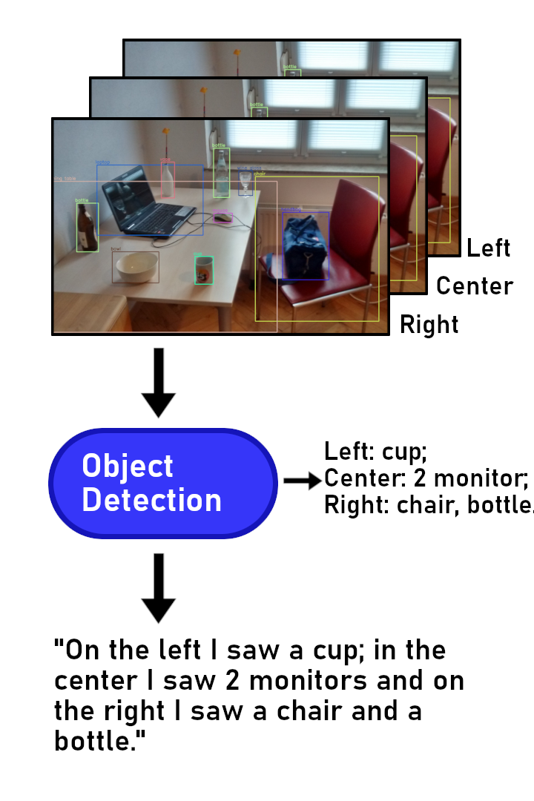
Object DETECTION NODE
Responsible for object detection, it exposes “capture_ended” service
When the “Capture” node publishes on “/frame_read” topic, it obtains by message the frame image and the head position associated to it
Then performs the objects detection and objects counting tasks
When the “head_movement” node has finished to acquire images, it calls the “capture_ended” service, then the object_detection node prepare a string containing all objects and the cardinality of these, acquired during detection task, for each head position.
This string is given to “animated_speech” node through “animatedSay” service

Slide 9
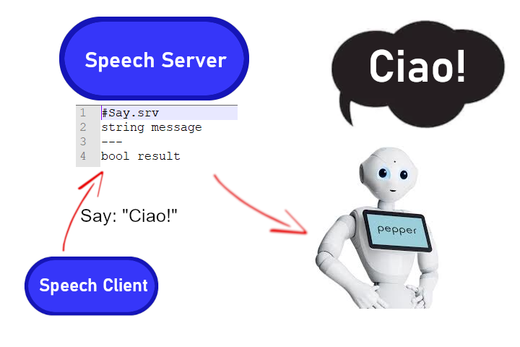
Speech Node
It allows to make Pepper talk in an expressive way;
Implemented as a Service Server of «AnimatedSay»;
It receives the text thourgh the service request and annotate the things he recognizes to choose contextual moves;
It obtains a Proxy of NaoQi framework «ALAnimatedSpeech», to which the ip has to be specified.

Slide 10
More details:
Topics:
For the acquisition of images from Pepper’s camera: /pepper_robot/camera/front/camera/image_raw
Services:
To publish image messages from stream_capture to object_detection node: /frame_read
To send head Pitch and Yaw coordinates to Pepper: /pepper_robot/pose/joint_angles
For capturing an image from the camera video: Capture
To communicate that the capture ended: capture_ended
To send a string to the animated_speech node: animatedSay

Slide 11
